Slide 1
Numerical Integration
Review of C++ Functions
MTH 125

Slide 2
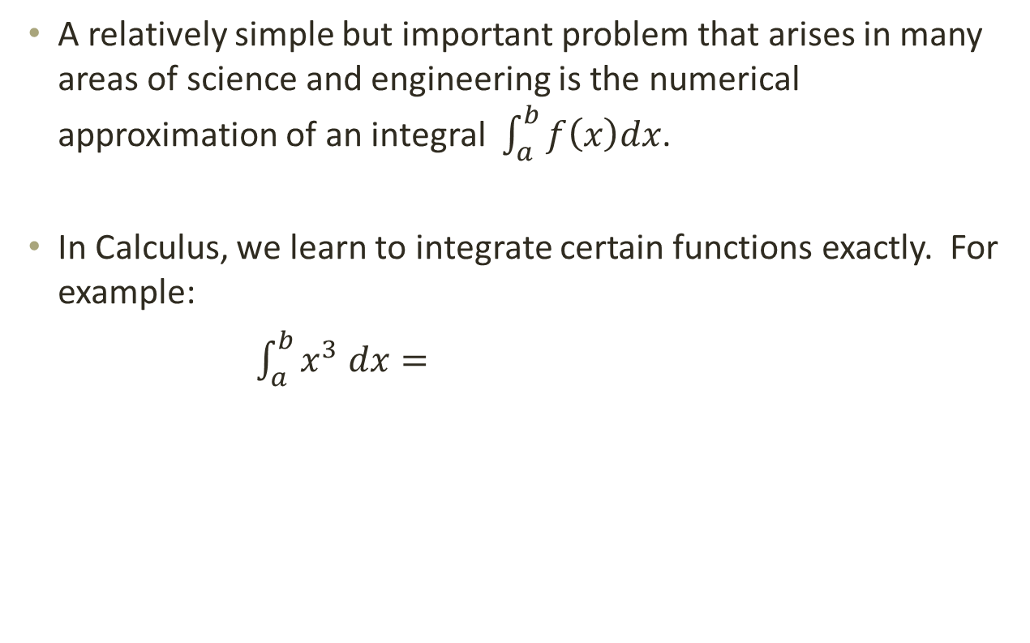
Introduction
A relatively simple but important problem that arises in many areas of science and engineering is the numerical approximation of an integral $\int_{a}^{b}{f\left(x\right)dx}$.
In Calculus, we learn to integrate certain functions exactly. For example:
$\int_{a}^{b}{x^{3} dx=}$

Slide 3
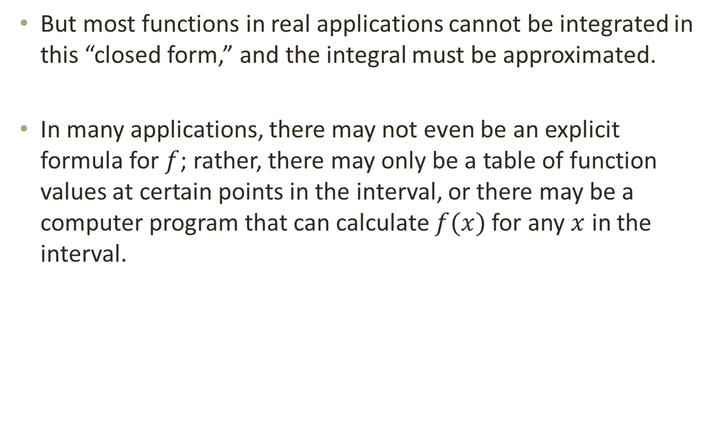
Introduction
But most functions in real applications cannot be integrated in this “closed form,” and the integral must be approximated.
In many applications, there may not even be an explicit formula for $f$; rather, there may only be a table of function values at certain points in the interval, or there may be a computer program that can calculate $f(x)$ for any $x$ in the interval.

Slide 4
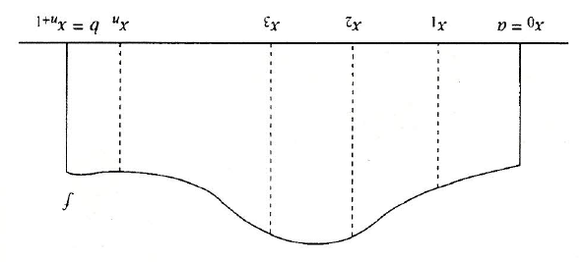

Area Under a Curve
The integral may be interpreted as the area under the curve of $f$ from $a$ to $b$.
An approximation to the integral can be obtained by introducing points $x_{1}, …, x_{n}$ between $a$ and $b$, as shown, and then approximating the integral on each subinterval $\left(x_{i},x_{i+1}\right)$ by the area of an approximating rectangle or other simple geometric figure.

Slide 5
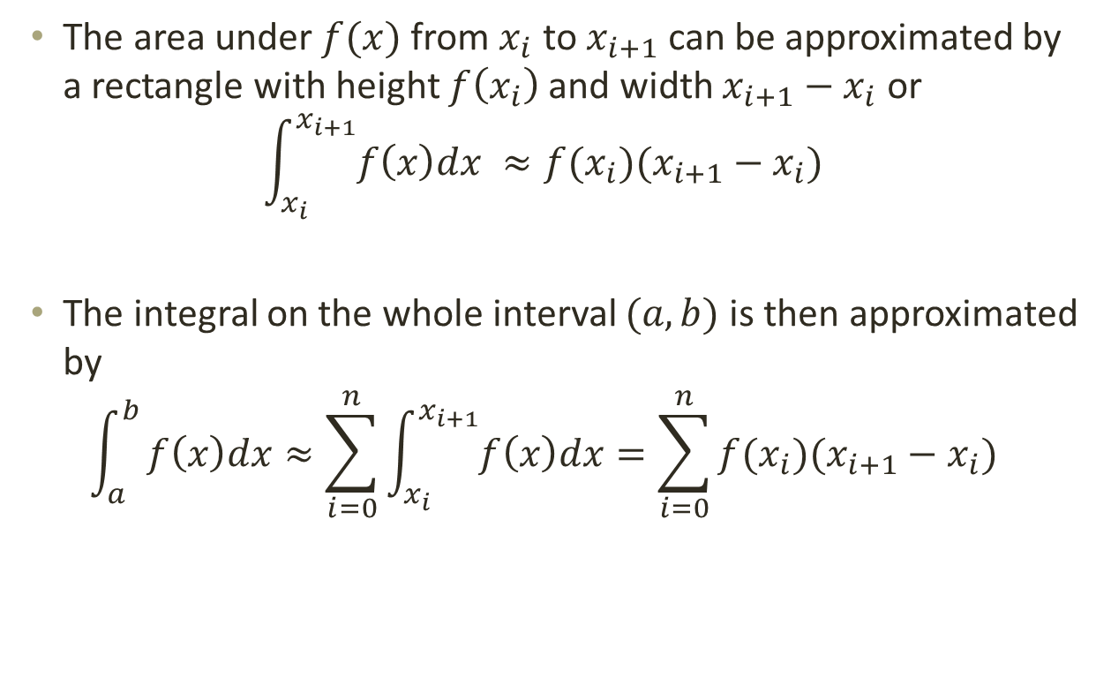
Rectangle (Left Endpoint) Rule
The area under $f(x)$ from $x_{i}$ to $x_{i+1}$ can be approximated by a rectangle with height $f\left(x_{i}\right)$ and width $x_{i+1}−x_{i}$ or
$$\int_{x_{i}}^{x_{i+1}}{f\left(x\right)dx ≈f(x_{i})(x_{i+1}−x_{i})}$$
The integral on the whole interval $(a,b)$is then approximated by
$$\int_{a}^{b}{f\left(x\right)dx≈\sum_{i=0}^{n}{\int_{x_{i}}^{x_{i+1}}{f\left(x\right)dx}=\sum_{i=0}^{n}{f(x_{i})(x_{i+1}−x_{i})}}}$$

Slide 6
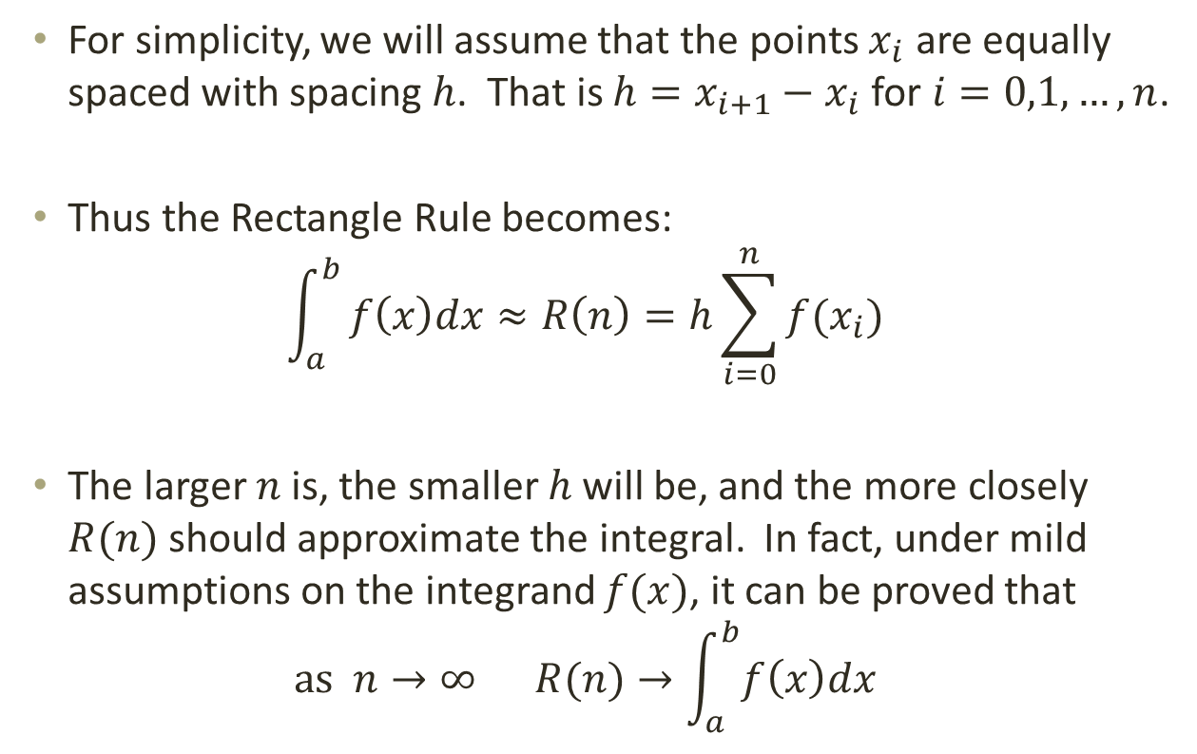
Rectangle Rule
For simplicity, we will assume that the points $x_{i}$ are equally spaced with spacing $h$. That is $h=x_{i+1}−x_{i}$ for $i=0,1,…,n$.
Thus the Rectangle Rule becomes:
$$\int_{a}^{b}{f\left(x\right)dx≈R\left(n\right)=h\sum_{i=0}^{n}{f(x_{i})}}$$
The larger $n$ is, the smaller $h$ will be, and the more closely $R(n)$ should approximate the integral. In fact, under mild assumptions on the integrand $f(x)$, it can be proved that
$$\text{as} n→∞ R(n)→\int_{a}^{b}{f\left(x\right)dx}$$

Slide 7
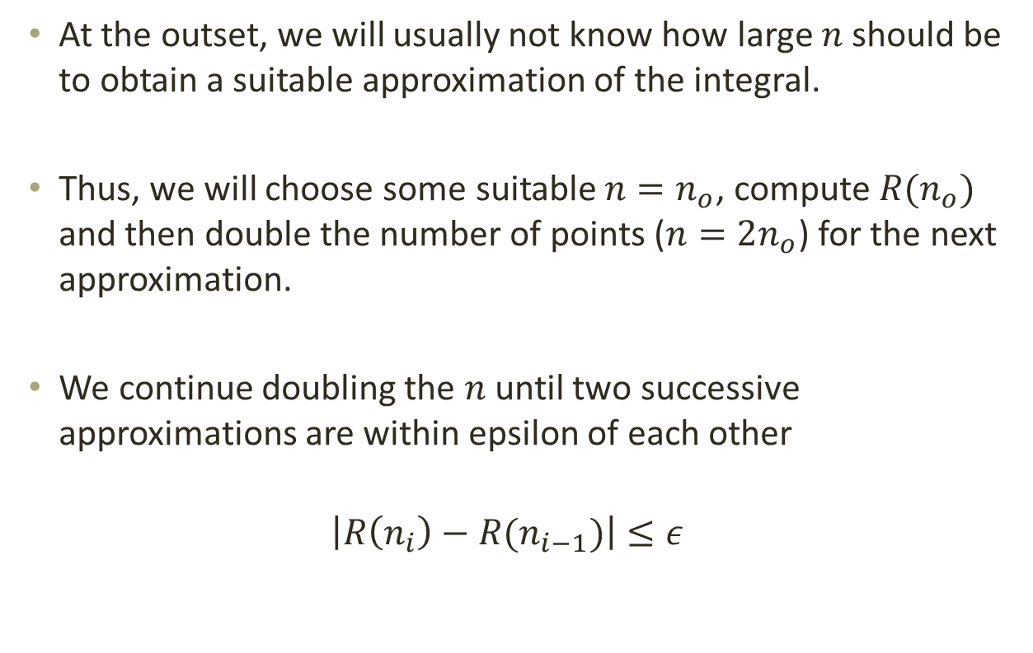

What $n$ to use
At the outset, we will usually not know how large $n$ should be to obtain a suitable approximation of the integral.
Thus, we will choose some suitable $n=n_{o}$, compute $R(n_{o})$ and then double the number of points ($n=2n_{o}$) for the next approximation.
We continue doubling the $n$ until two successive approximations are within epsilon of each other
$$\left|R\left(n_{i}\right)−R(n_{i−1})\right|≤ε$$

Slide 8
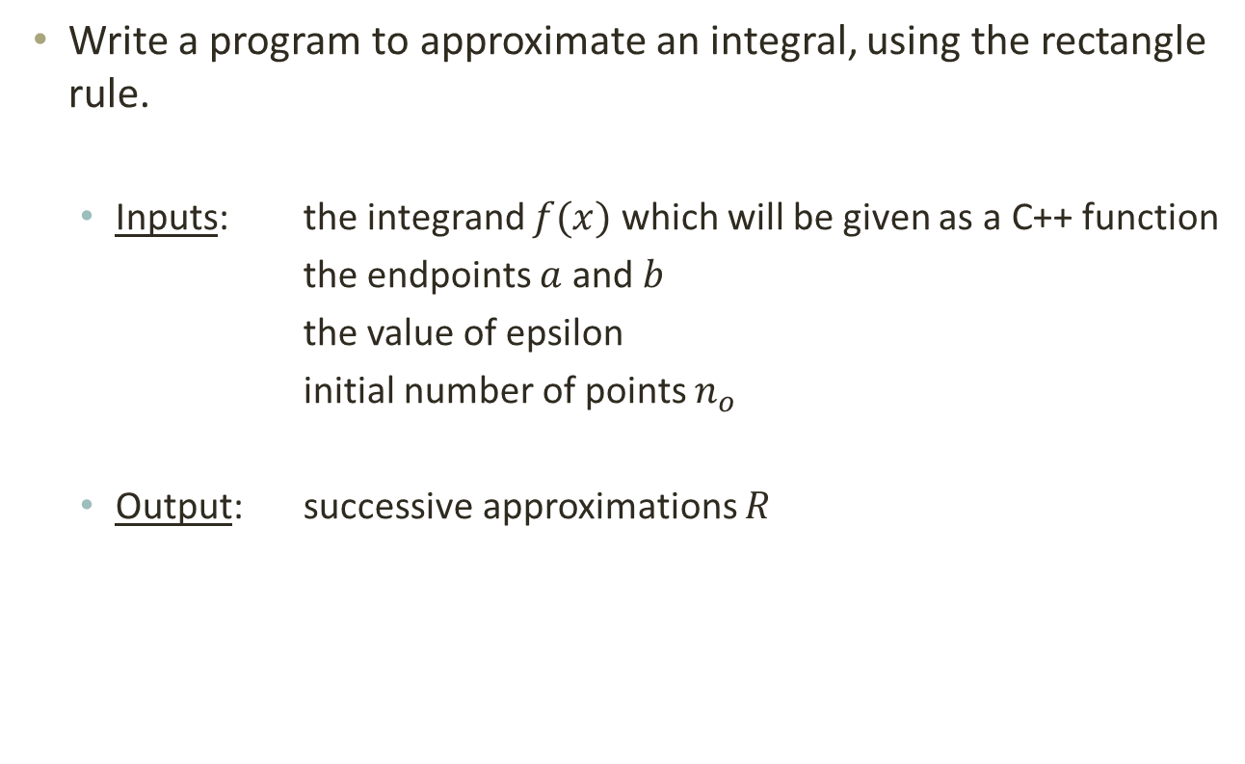
Program
Write a program to approximate an integral, using the rectangle rule.
Inputs: the integrand $f(x)$ which will be given as a C++ function
the endpoints $a$ and $b$
the value of epsilon
initial number of points $n_{o}$
Output: successive approximations $R$

Slide 9
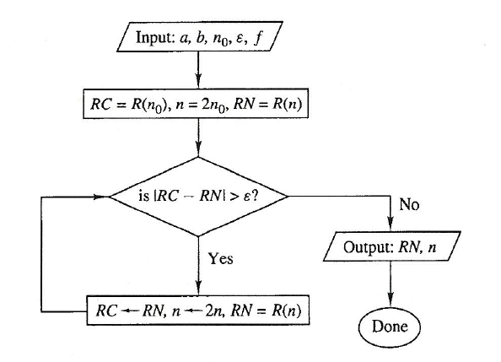
Flow Chart for Main Program

Slide 10
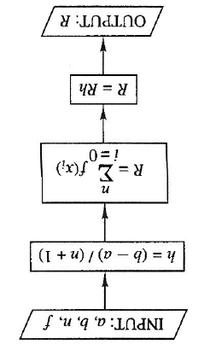
Flow Chart for Rectangle Rule Function

Slide 11
Rectangle Rule Function
/** Computes the rectangle rule approximation to the integral
of a function
@param a the left endpoint of the integral
@param b the right endpoint of the integral
@param n the number of rectangles used
@return the approximation of the integral
*/
double rectangle(double a, double b, int n)
{
double h = (b – a)/(n + 1);
double x = a;
double value = f(x);
for (int i = 0; i <= n; i++)
{
x = x + h;
value = value + f(x);
}
return value * h;
}

Slide 12
The Program
#include <iostream>
#include <cmath>
/* This program will approximate an integral by using more and more points in the rectangle rule. It requires a function program for the integrand, the interval (a,b) of integration, an initial number of points n0 for the approximation, and a convergence parameter epsilon */
/** function to be integrated
@param x the value at which to evaluate f
@return the value of f(x)
*/
double f(double x)
{
return x / (1. + x*x);
}

Slide 13
/** Computes the rectangle rule approximation to the integral
of a function
@param a the left endpoint of the integral
@param b the right endpoint of the integral
@param n the number of rectangles used
@return the approximation of the integral
*/
double rectangle(double a, double b, int n)
{
double h = (b – a)/(n + 1);
double x = a;
double value = f(x);
for (int i = 0; i <= n; n++)
{
x = x + h;
value = value + f(x);
}
return value * h;
}

Slide 14
int main()
{
int n0;
double a, b, epsilon;
// prompt for input
cout << “Please enter values for a, b, n0, and epsilon: “;
cin >> a >> b >> n0 >> epsilon;
// echo the input
cout << “a = “ << a << “ b = “ << b << endl;
cout << “n0 = “ << n0 << “ epsilon = “ << epsilon << endl;
// compute the first two approximations to the integral
double RC; // will hold the current approximation
RC = rectangle(a, b, n0);

Slide 15
// double the number of rectangles
int n = 2. * n0;
double RN; // will hold the next approximation of the integral
RN = rectangle(a, b, n);
// repeat integral approximations until converge
while (fabs(RN – RC) > epsilon)
{
n = 2. * n; // double n
RC = RN; // save current approximation
RN = rectangle(a, b, n); // compute next approximation
// display result
cout << “Integral = “ << RN << “ for n = “ << n << endl;
}
return 0;
}

Slide 16

Test Run
Use $a=0, b=1, n_{o}=2,$ and $ε=0.001$
The exact solution to the integral is
$$\int_{0}^{1}{\frac{x}{1+x^{2}}} dx=$$

Slide 17
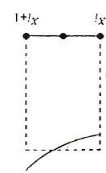
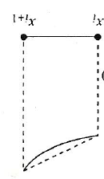
Other Rules
Midpoint Rule
Trapezoid Rule
Simpson’s Rule

